Slide 1
Social Security and Railroad Retirement Equivalent
Pub 4012 – Tab D
Pub 4491 – Lesson 15
Notes:
Social Security is frequently seen in Tax-Aide prepared returns
All counselors should have a thorough working knowledge of this material
Self Employment Insurance Deduction is a comprehensive topic. Details found in slide deck 26 Adjustments to Income
Lump-Sum benefits is a comprehensive topic and not often seen

Slide 2
Lesson Topics
Social security income
Tier 1 Railroad retirement benefits
Comprehensive topics
Foreign old age payments
Lump sum social security payments

Slide 3
Intake and Interview
All social security income in scope
Refer lump-sum payment for prior year to experienced counselor
Prior year returns are required to complete lump-sum payment
Notes:
Ask for Social Security statement SSA-1099 and/or Railroad Retirement RRB-1099 if line 13 is checked either Yes or Unsure.
If any lump-sum payments, does taxpayer have returns for those years?

Slide 4
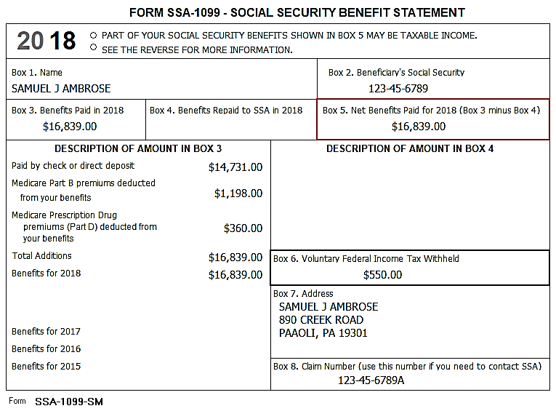
Form SSA-1099
Notes:
Make sure to use Form SSA-1099 and not the estimate for the next year. Sometimes taxpayers mistakenly bring in that form.
Combine Part B and Part D premiums and enter in Medicare premiums
TaxSlayer applies Medicare premiums to Schedule A medical expenses. If taxpayer is self-employed and qualifies for self-employed health insurance deduction, then Medicare premiums will be entered on Schedule C, not here. See Standard Deduction Qualified Business Income Deduction (Slide Deck #27)for more detail.

Slide 5
Social Security Income in TaxSlayer
Pub 4012 Tab D
Enter data for both Taxpayer and Spouse
Enter any federal withholding
If return includes Schedule C income:
Medicare costs may be deductable as self-employed health insurance – enter on Schedule C not social security screen
See slide deck 26 Adjustments to Income for details
If no Schedule C income enter Medicare cost in social security screen

Slide 6
Railroad Retirement Benefits – Tier 1
Railroad Retirement Tier 1
Blue Form RRB-1099
Refer to Pub 4012 Tab D for Details
Same rules as social security
Enter data on social security line SSA-1099 input screen
Notes:
Most sites never see Railroad Retirement forms, but topic can be on the test.
All counselors should be aware that Railroad Retirement is a special and different than normal 1099-R income.
Some sites have many Railroad Retirees.

Slide 7
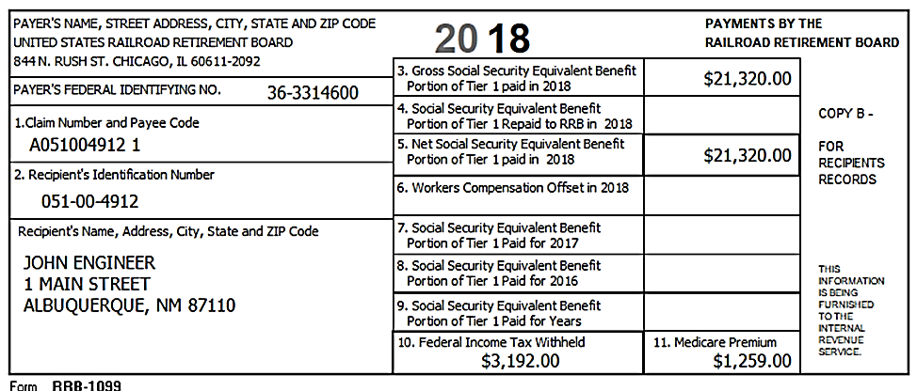
Railroad Retirement Benefits
Confirm it’s social security equivalent and not Railroad retirement
Notes:
Click 1 – Box 5 Net Social Security Equivalent Benefit to be entered on SSA-1099 input screen.
Click 2 – Box 11 – Medicare Premium total.
Click 3 – Box 10 – Federal Income Tax Withheld.
Railroad retirement form is green; Social Security equivalent is BLUE

Slide 8
Railroad Retirement Benefits – Tier 2
Railroad retirement Tier 2
Green form is RRB-1099-R
Retirement pension
NTTC Pub 4012 Tab D entry information
Notes:
Most sites never see Railroad Retirement forms, but topic can be on the test.
All counselors should be aware that Railroad Retirement is a special and different than normal 1099-R income.
Some sites have many Railroad Retirees.

Slide 9
Quality Review
Check accuracy of input
Check if Federal income tax withheld
Medicare payments entered on correct form
Schedule C or social security screen (Schedule A
Determine if lump-sum worksheets needed
Benefits paid for multiple years
Notes:
Lump-sum worksheet comprehensive lesson next section

Slide 10
Comprehensive Topics

Slide 11
Foreign Old Age Payments
NTTC Modified Pub 4012 Tab D
Treated as U.S. social security (Pub 915)
Canada Pension Plan
Quebec Pension Plan
Old Age Security from Canada
Germany social security
Taxpayer must provide US dollar amounts
Other countries and pensions other than above – out of scope

Slide 12
Lump-Sum Social Security
Do not amend prior year returns for lump-sum social security payments
Use lump-sum calculation if
Portion of social security income taxable
Taxpayer has tax liability
Check the Summary after entering all other tax return data
Notes:
12
Sometimes if a taxpayer files for disability, it takes a long time to work through the approval process. This can result in social security allocated to several years. An example is shown on the next chart.
For multiple year social security it may be possible that there isn’t any tax impact if all of the social security is entered as lump-sum for the current year. If there is an impact it may be better to use lump sum worksheets for each year; however, the AGI, taxable social security, total social security and tax exempt interest are needed for each year. If lump sum is used, taxpayer must have tax returns available for those years.

Slide 13
Lump-Sum Social Security
Do not amend prior year returns with lump-sum social security payments
Depending on on income total lump-sum social security income may not be taxable
No tax liability; lump-sum worksheets not needed
Use lump-sum worksheet if
Portion of social security income taxable and
Return has tax liability
Check Summary after entering all tax return data
Notes:
13
Sometimes if a taxpayer files for disability, it takes a long time to work through the approval process. This can result in social security allocated to several years. An example is shown on the next chart.
For multiple year social security it may be possible that there isn’t any tax impact if all of the social security is entered as lump-sum for the current year. If there is an impact it may be better to use lump sum worksheets for each year; however, the AGI, taxable social security, total social security and tax exempt interest are all needed for each year. If lump sum is used, taxpayer must have tax returns available for those years.

Slide 14
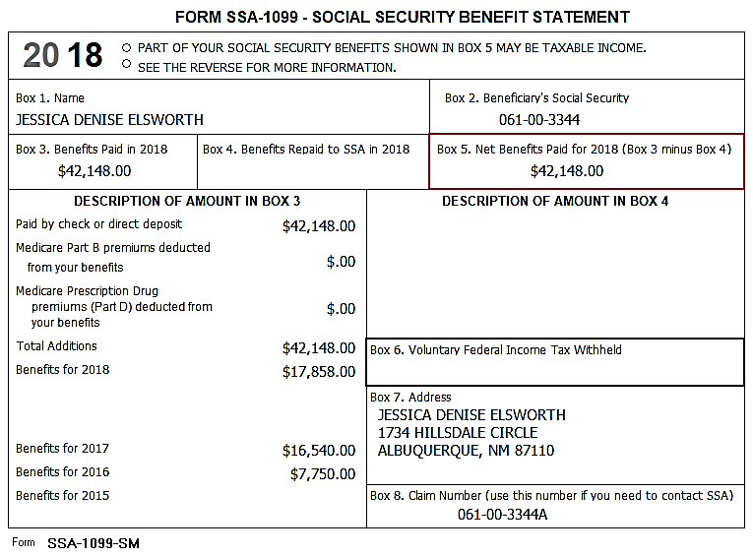
SSA -1099 Lump Sum Distribution
Benefits paid may include lump-sum payments for prior years
Prior year amounts shown in description block Form SSA-1099
Notes:
If attorney fees are included in the Description of Amount in Box 3 section, those attorney fees are no longer deductible on Schedule A however, check for possible state deduction still in place.

Slide 15
Start With SSA-1099 Input Screen
Enter entire amount on current year input screen
Begin Worksheet for Lump-Sum Payments
Select prior year and enter requested information
Find SSA-1099 Lump-Sum Distributions page in Pub 4012 Tab D for data entry
Notes:
Taxpayer MUST have previous year(s) return(s)

Slide 16
Lump-Sum Calculation
NTTC Modified Pub 4012 Tab D
What is included in the Modified AGI for lump-sum calculation?
Adjusted gross income
Plus tax-exempt interest
Plus student loan interest
Plus adoption benefits
See Pub 4012 for complete formula for Modified AGI
Notes:
Instructor: Have learners find the SSA-1099 Lump-Sum Distributions page in 4012. And answer the question

Slide 17
Lump-Sum Calculation
Taxpayer must have copies of prior year returns
Enter social security income received in prior year
TaxSlayer calculates and applies lower taxable amount from Lump-Sum worksheets to current year return

Slide 18
Social Security Income
Questions?
Comments ...

